Slide 2

DevQuest
Your developer storyline , should you choose to accept it .

Slide 3






PROBLEMS

Slide 4




1.Lack of focused pathways for students
2.Inefficient and outdated tech hiring methodologies judging only competitiveness
3. Difficult for students to find like minded team mates for collaboration
PROBLEMS THAT WE ARE SOLVING
Problems

Slide 5



Devquest
Shaping you developer journey from 0 to 1

Slide 6



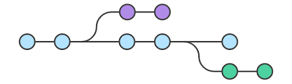
Features of our Platform
Curated Pathways
Reward Based Learning
Bridging the Hiring Gap
Specially crafted pathways for beginners, intermediates and advanced learning of development stacks
Enables students to earn points for completing weekly competitions and attending events.
Specialized score based system based on multiple parameters to judge the student's abilities and provide job opportunities

Slide 7



Features of our Platform
Gamified Learning Environment
Buddy System
Badge of Completion
Each pathway consists of quests which tests the what the student has learned through in a gamified manner.
Enables students to pair up with students of similar intrests to learn in a peer group environment.
Specialized score based system based on multiple parameters to judge the student's abilities and provide job opportunities

Slide 8
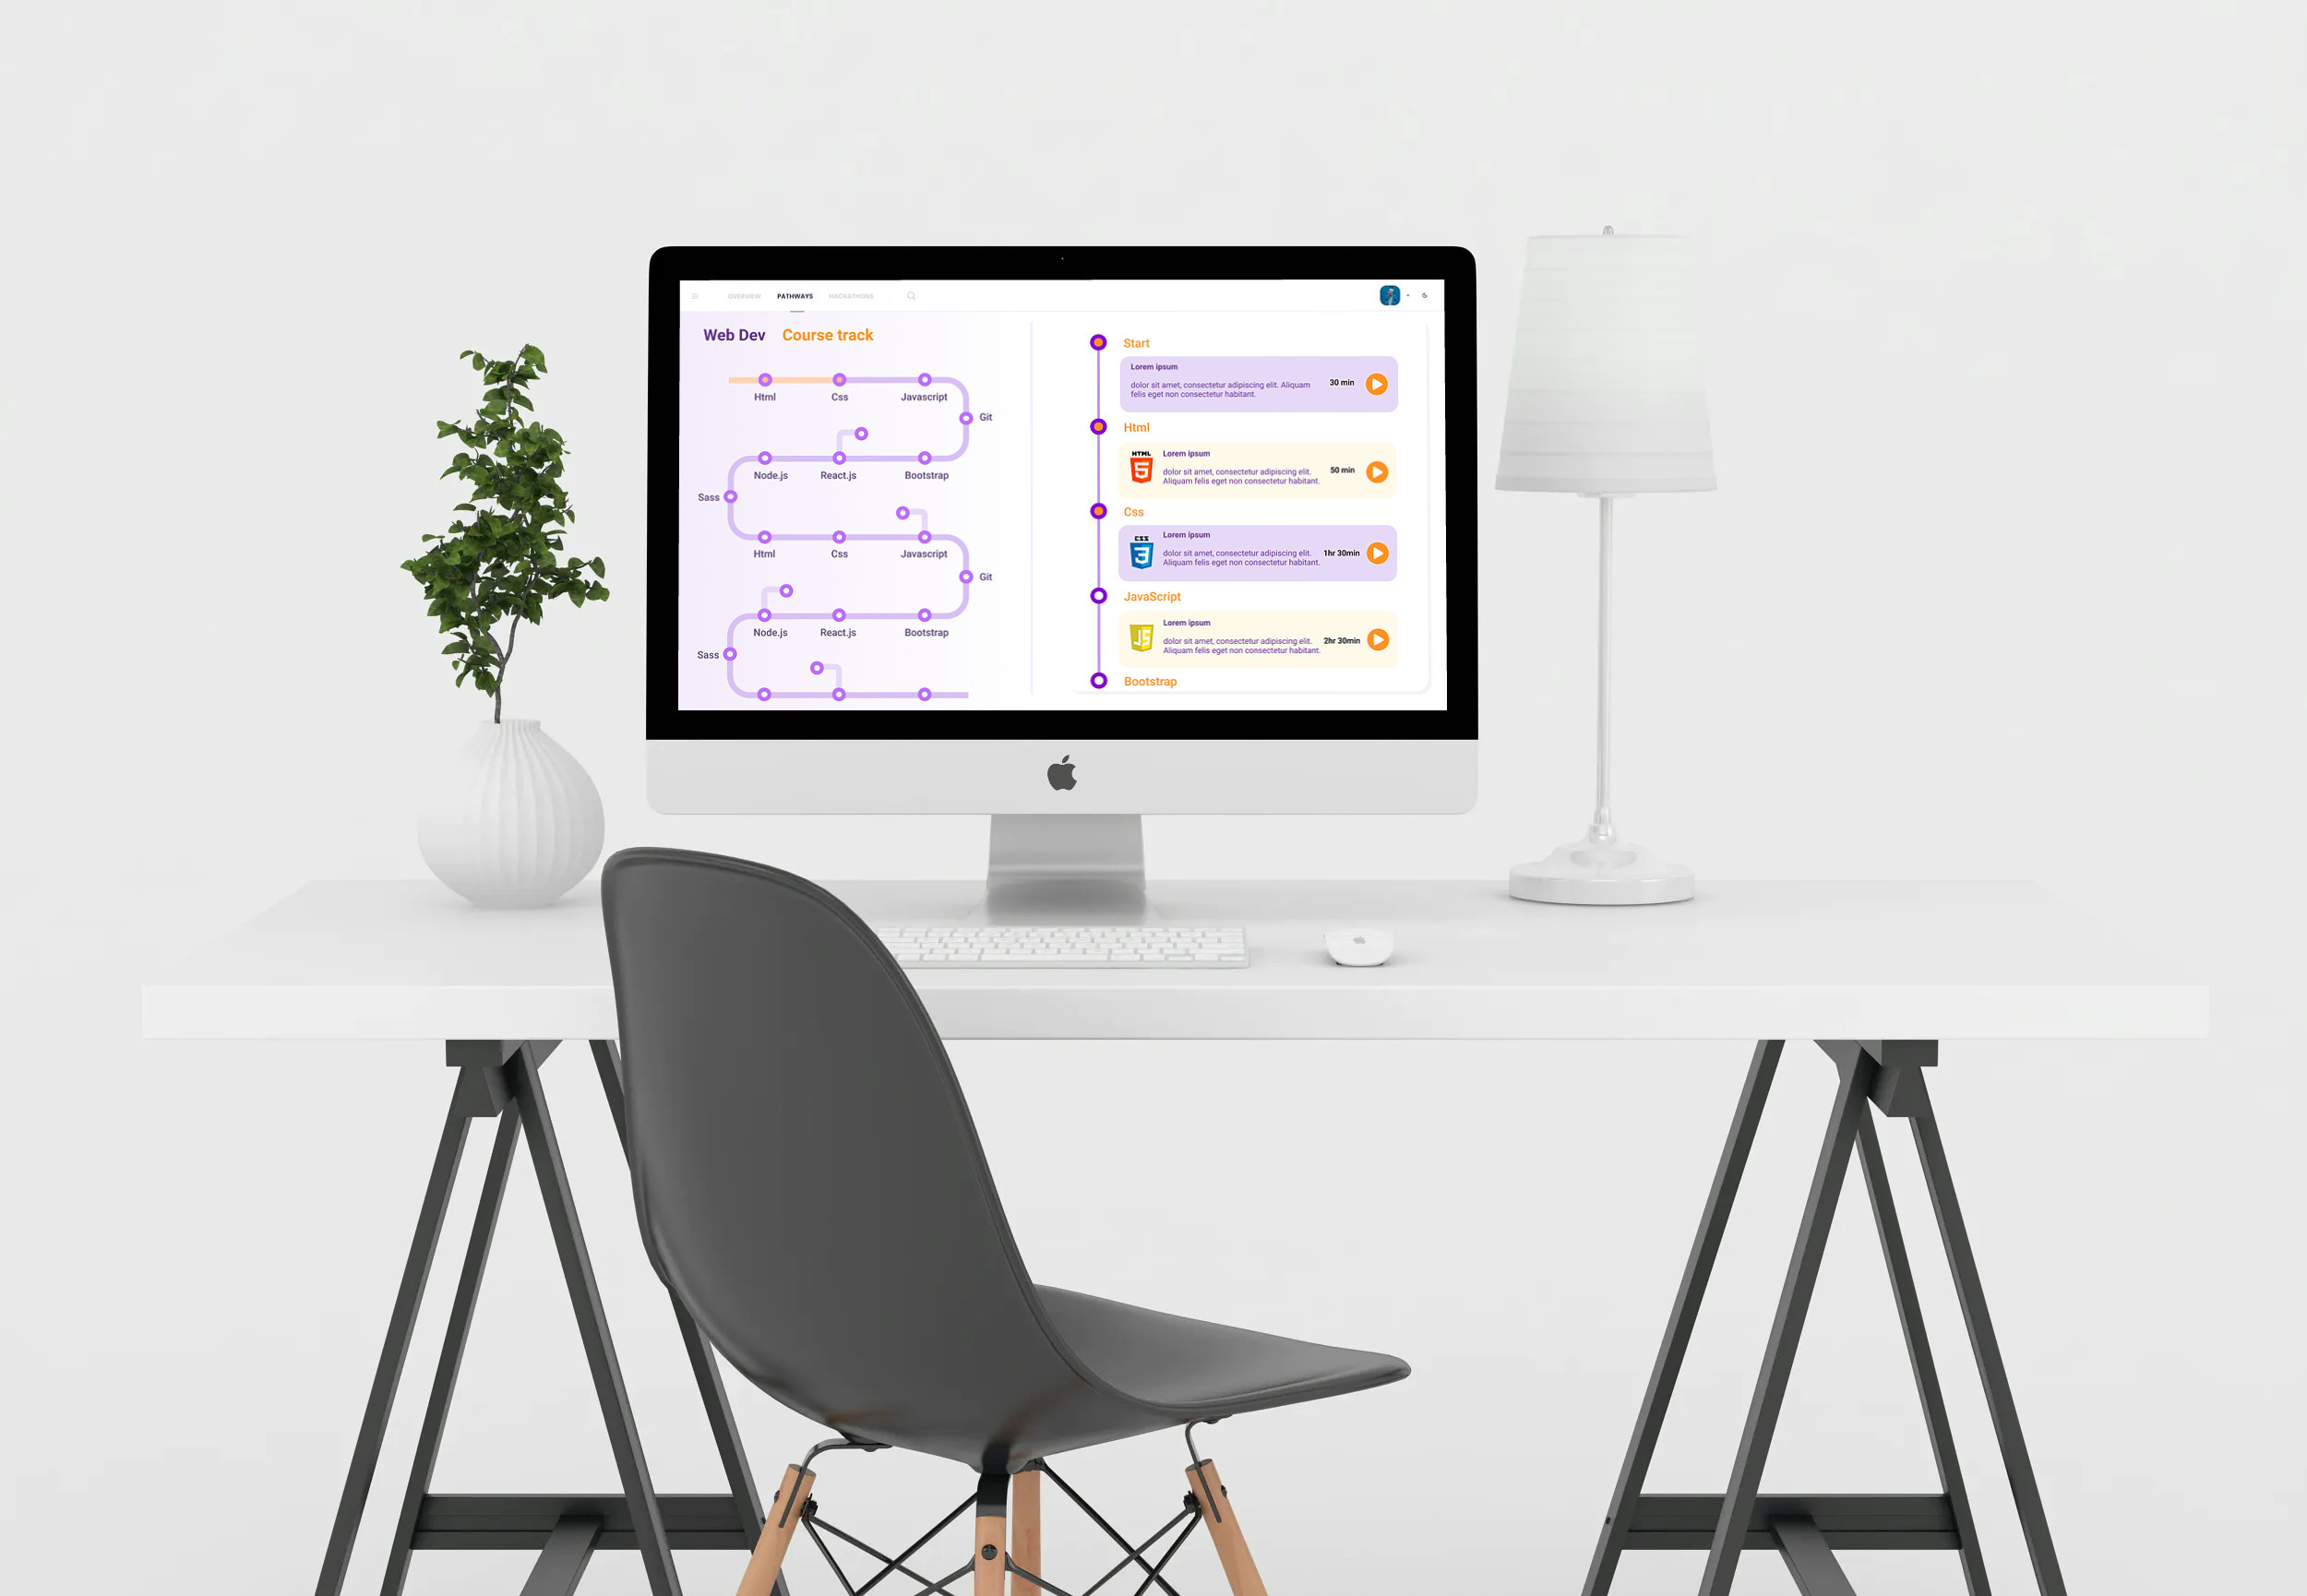

Slide 9
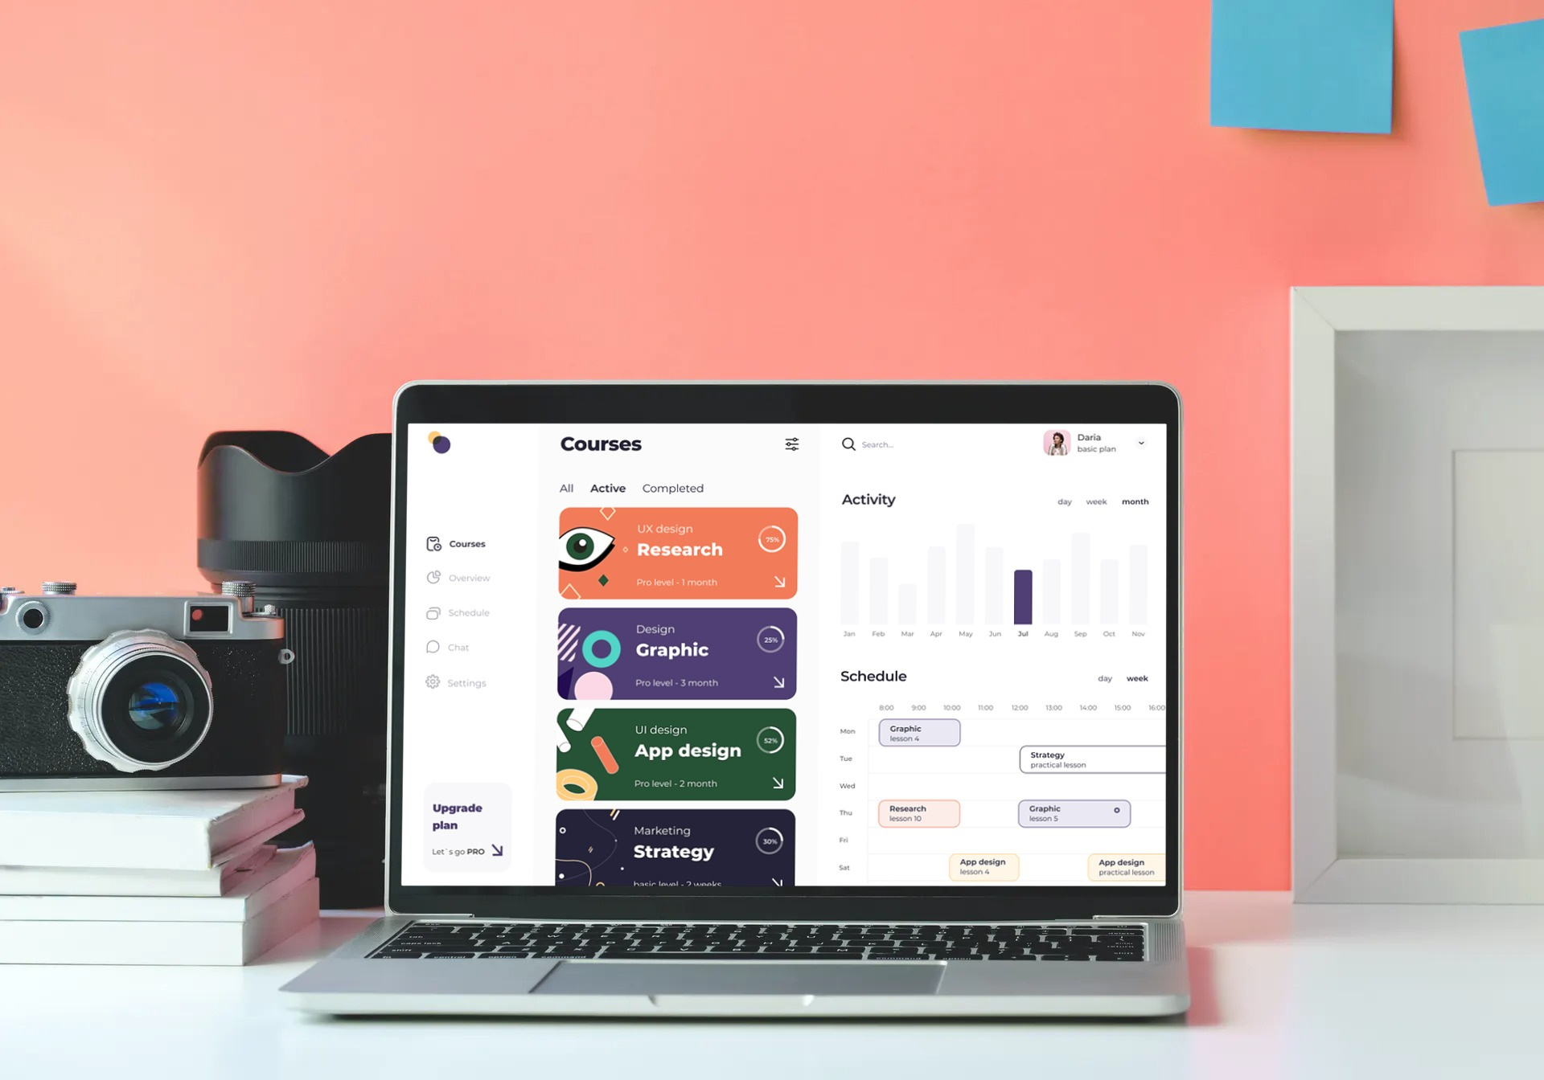

Slide 10


Slide 11
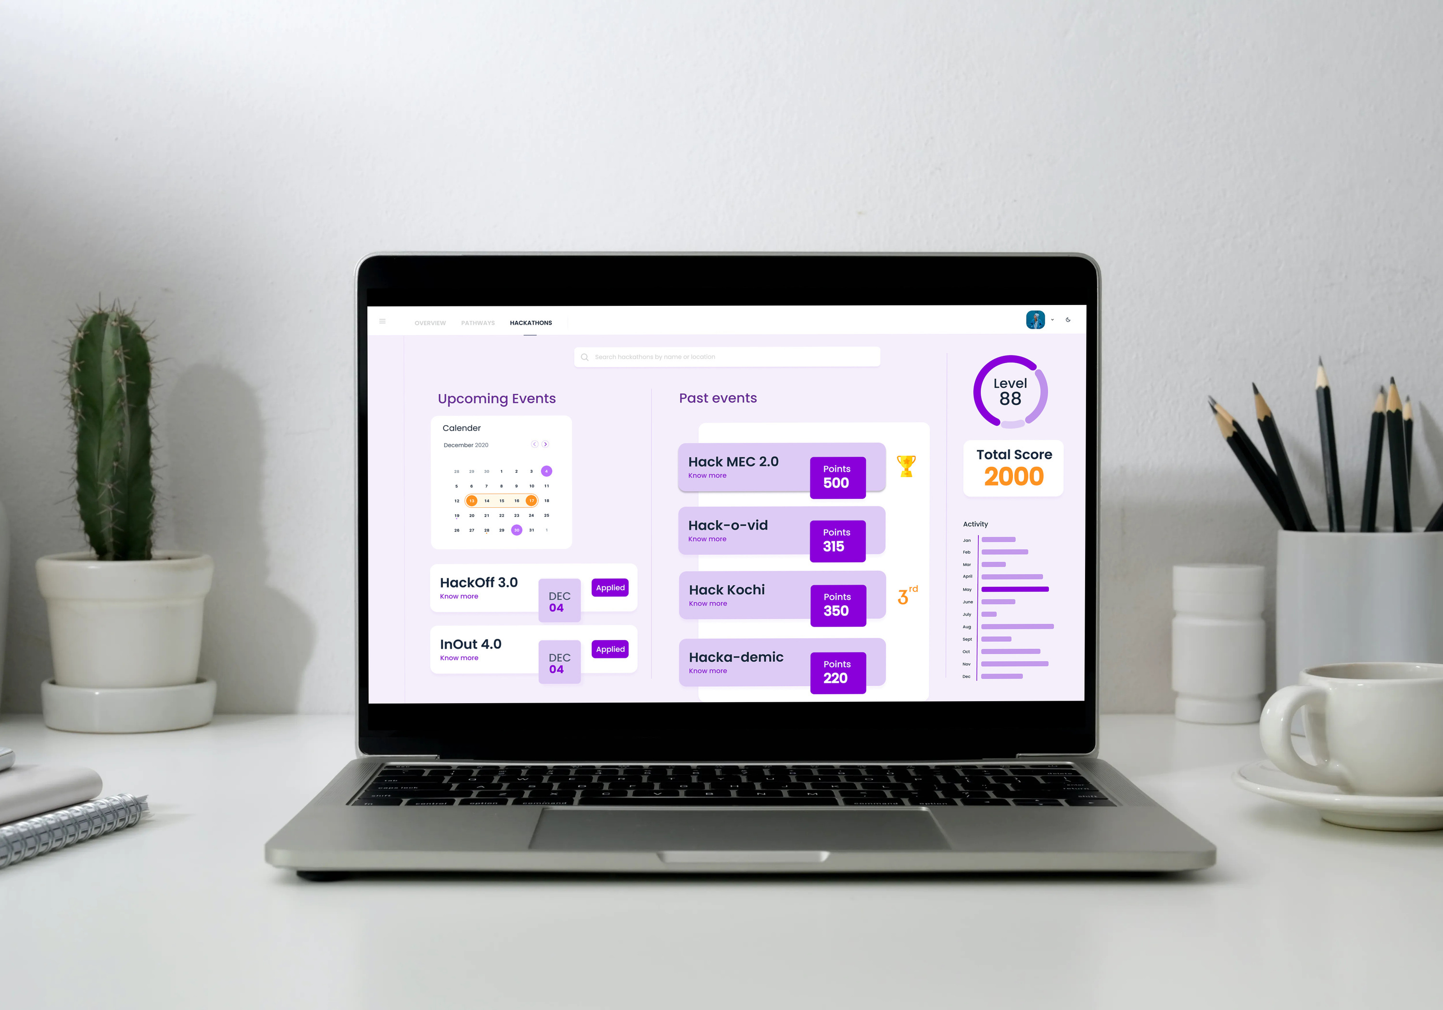

Slide 12

DEVELOP MVP
KTU COLLEGES
Our Plan
BUILD USERBASE
LAUNCH DevQuest
PROVIDE INTERNSHIPS

Slide 13

EdTech
Swag and
merch
Buddy
System
DevQuest
Product placements
Job/Internship Oppurtunities

Slide 14




WHY YOU SHOULD INVEST?

Slide 15
$20 Billion
1.9 Billion
Size of the Market
TOTAL AVAILABLE MARKET (TAM)
Some sizing jargons
$1.8 Billion
1.9 Billion
SERVICEABLE AVAILABLE MARKET (SAM)

Slide 16
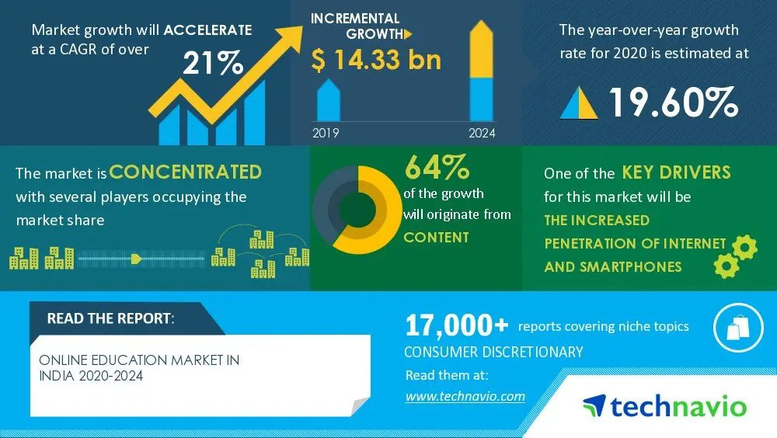
MARKET SIZE

Slide 17
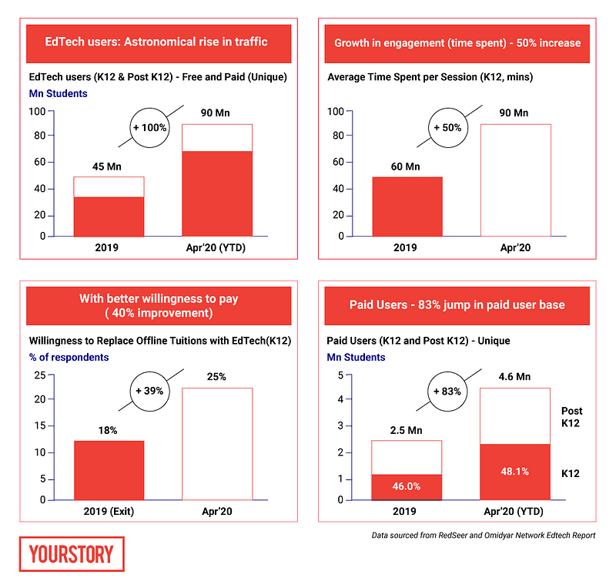
India’s edtech market will touch $3.5B by 2022: RedSeer and Omidyar Network India report

Slide 18
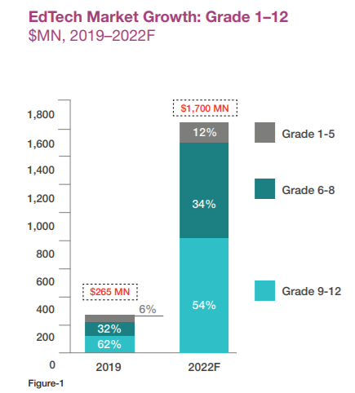
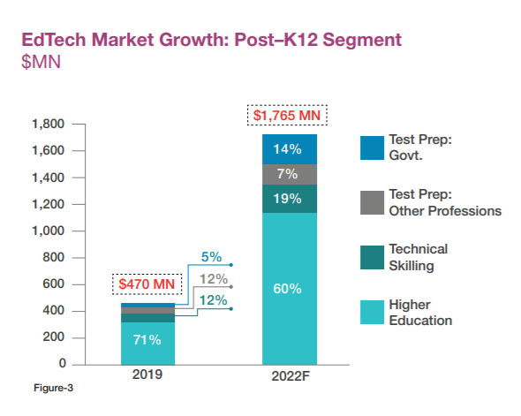
Source: Omidyar Network India

Slide 19


K-12 Students
Any student in the K-12 category who who is looking to start learning coding
Target Market
PITCH DECK V 1.0
Undergrads
Who are the customers we cater to?
College students who are looking to get into learning development for future career.

Slide 20
The Pandemic World
Due to lockdown and being at home the online EdTech market has seen a huge surge of consumers especially student developers looking to upskill themselves
It is the need of the hour.
Timing
Coding helps students think, visualise, and express themselves or talk about societal issues.The Indian education system is flawed and relies on memorization rahter than practical knowledge.More and more people are realizing this and are looking for platforms which can provide them with this approach.
DEVQUEST
Now is the best time to launch DevQuest
Post Pandemic world
The new National Education Policy (NEP) calls for introducing coding for classes 6 and above.We believe that as we move past the pandemic era, the demand for this coding culture will increase.

Slide 21




Step 1
Development of MVP
DEC 2020
Step 2
Internal Testing- Within MEC
Milestones
Our plan for the next year
Step 3
User Testing - Under KTU colleges
April 2021
Step 4
Beta Launch
May 2021
June 2021

Slide 22





Codec Accademy
Direct Competitors
Skillcrush
Coding Ninjas
Indirect Competitors
WhiteHatJr
White hat Jnr
Upgrad

Slide 23

Competitive Advantages
The Utopia

Slide 24
GAMIFYING LEARNING
We provide a reward based and interactive learning experience for learning coding that no other platform currently provides.
Our Approach
PRACTICAL HIRING TECHNIQUES TO ASSESS CANDIDATES
A platform that provides the employer with a candidate profile that reviews both the skillset and practical experience
REWARD BASED LEARNING
Providing positive reinforcement to students by rewarding them throughout their learning journey.

Slide 25

Business Model
Subscription based curated pathways and quests built by industry experts
DEVQUEST
Intergration with other non technichal upskilling platform
Product placement of partners as rewards for weekly competitions

Slide 26

Revenue Model : Pathways and quests
Free
High schooler
Undergrad
Access to roadmap previews
Access to all highschooler quests
Access to all undergrad quests
Free access to first quest on all roadmaps
Quest submission and review
Quest submission and review
dicussion forums and doubt clearance
dicussion forums and doubt clearance
Basic resources
unlockable reward chests for completion of quests
unlockable reward chests for completion of quests
Intership and job oppurtunities
Rs 0/month
Rs 299/month
Rs 499/month

Slide 27

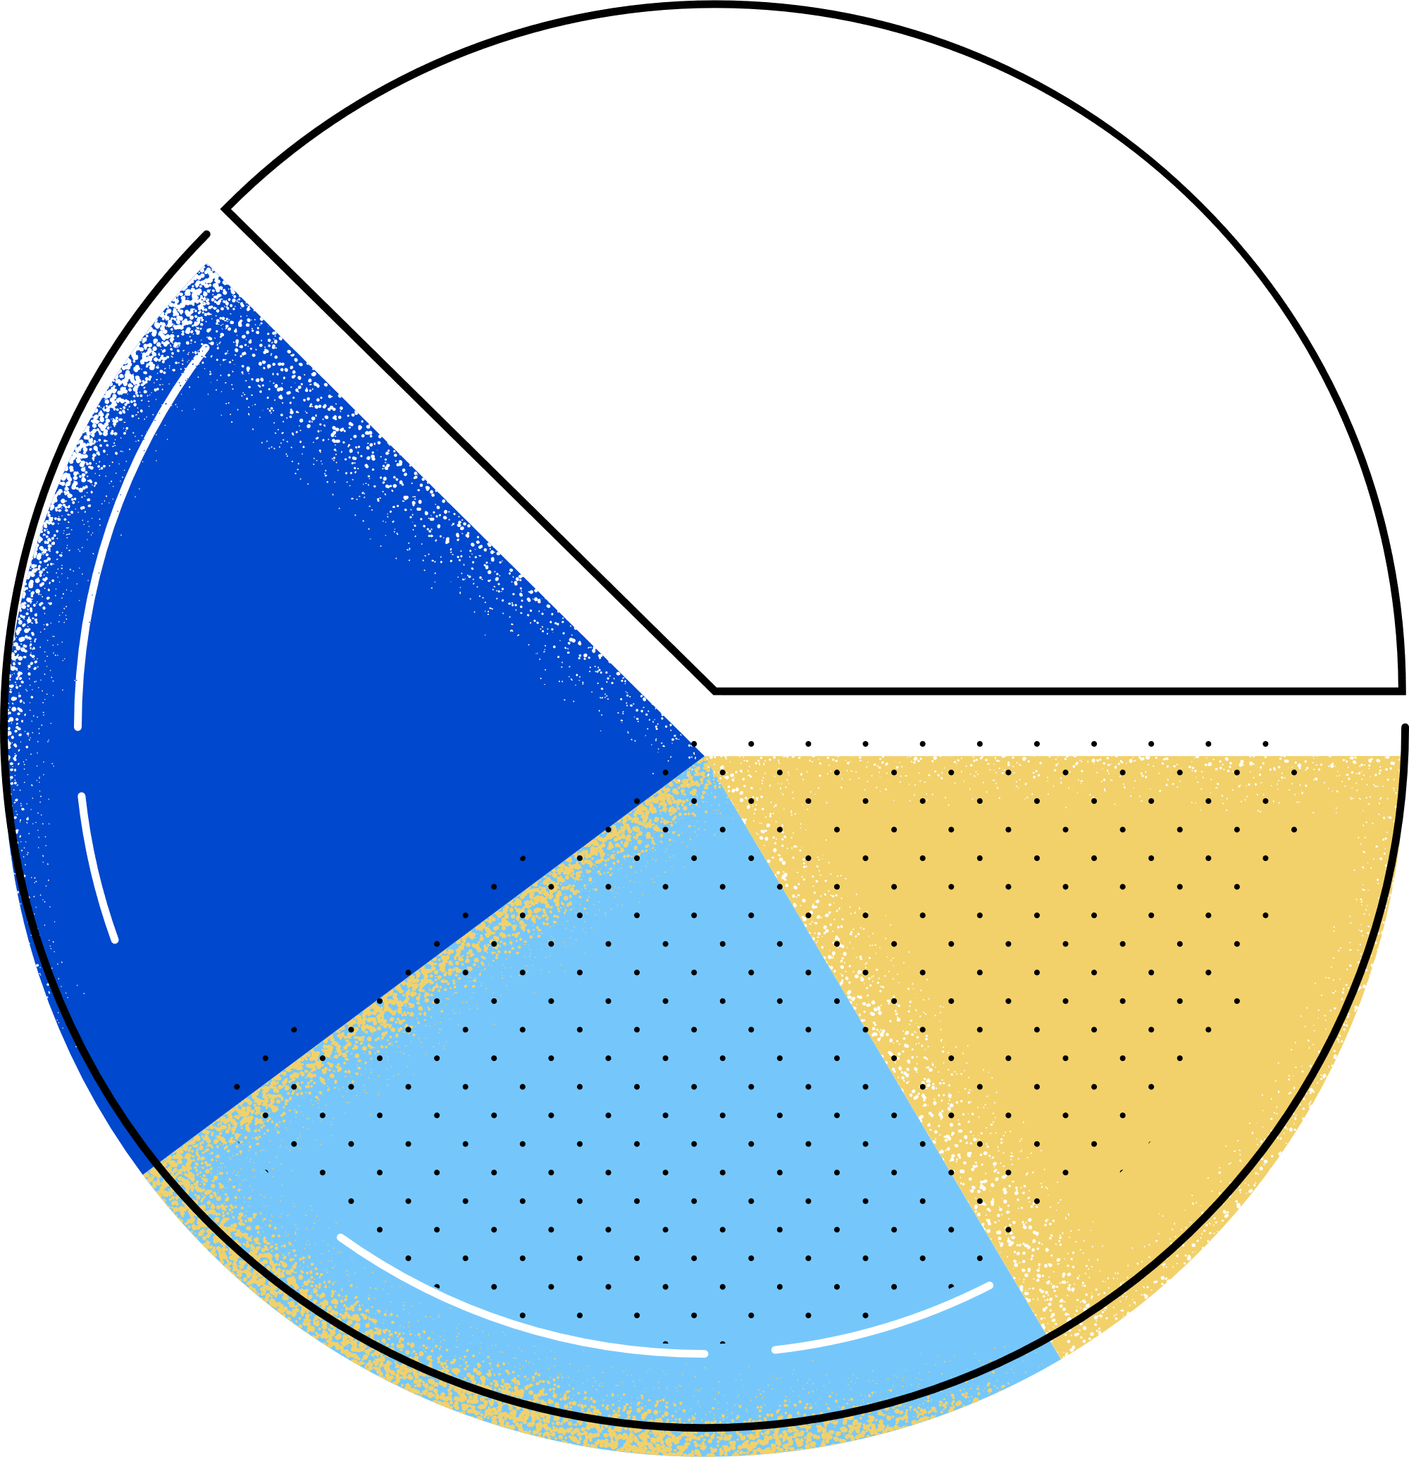


Bring in industry expert to design courses on the platform
Partner up with startups and companies to provide jobs and offers to students
Future Roadmap
Partner up with companies to promote their product
Our next steps and goals
Intergration with other non technichal upskilling platform

Slide 28
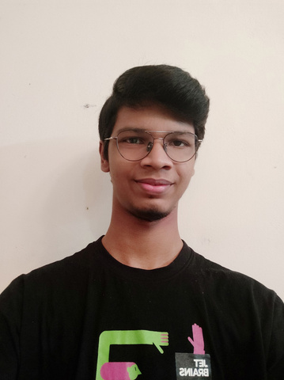



Adithya A
Product Architechure and development
Pranav H Nair
Frontend Developer
The Team
Steve Sam Jacob
Content
Vinayak Sidharth
Machine Learning and Data

Slide 29

Contact Us
+91 7012703717
adithyaanilkumar1@gmail.com
DEVQUEST

